Slide 1
MUTUAL FUND
ANALYTICS PLATFORM
Final Report | Bluestock Fintech Internship
PREPARED BY
DATE
TOOLS
Udayraj Gawande
June 2026
Python · SQLite · Power BI · Jupyter
Data Analytics Track | Jan 2022 – Dec 2025

Slide 2
02
Problem Statement & Objective
THE PROBLEM
THE OBJECTIVE
Indian retail investors lack actionable, data-driven tools to evaluate mutual fund performance, manage SIP discipline, and understand portfolio risk.
Fund distributors and AMCs have no unified view linking investor behaviour, market trends, and risk metrics in one platform.
1. Analyse 40 mutual fund schemes across 10 fund houses (Jan 2022–Dec 2025) 2. Build an ETL pipeline: AMFI data + live NAV → cleaned SQLite database 3. Perform EDA across 32,778 investor transactions from 5,000 investors 4. Deliver a 4-page Power BI dashboard covering industry, performance, behaviour & risk
40
10
5,000
4 Years
Schemes
Fund Houses
Investors
Coverage
Notes:
Explain the gap in the Indian MF market for data tools. State the 4 key deliverables.

Slide 3
03
Data Sources & Coverage
# | Dataset | Records | Key Fields
01 | fund_master.csv | 40 schemes | AMFI code, fund house, category, expense ratio
02 | nav_history.csv | 46,000 rows | AMFI code, date, NAV
03 | investor_transactions.csv | 32,778 rows | Investor ID, type, amount, state, age, gender
04 | scheme_performance.csv | 40 schemes | 1Y/3Y/5Y returns, Sharpe, alpha, beta, drawdown
05 | monthly_sip_inflows.csv | 48 months | SIP inflow (₹Cr), active accounts
06 | benchmark_indices.csv | 8,050 rows | NIFTY50, NIFTY100, BSE_SMALLCAP, CRISIL_GILT
07–10 | aum, folios, holdings, inflows | 650+ rows | AUM by fund house, sector weights, category inflows
4.6 MB
Raw Data
127K+
Data Points
10
Datasets
0
Null Values
Sources: AMFI Public Data · MFAPI.in REST API · Simulated Investor Transaction Records
Notes:
Highlight that all data was clean (0 nulls post-cleaning). MFAPI.in provided live NAV for 5 large-cap schemes.

Slide 4
04
ETL Pipeline Architecture
01 DATA INGESTION
02 CLEAN & TRANSFORM
03 LOAD TO DATABASE
live_nav_fetch.py MFAPI.in REST API 10 raw CSV files 01_data_ingestion.ipynb
02_data_cleaning.ipynb Date standardization Currency normalization Derived: YoY SIP growth
load_to_db.py SQLAlchemy ORM bluestock_mf.db (SQLite) if_exists='replace'
▶
▶
SQLite Schema — bluestock_mf.db
dim_fund
fact_nav
investor_transactions
scheme_performance
40 rows
46,000 rows
32,778 rows
40 rows
Fund master (AMFI code, name, category)
Daily NAV history per scheme
Full investor transaction ledger
Aggregated performance metrics
Notes:
Walk through each stage briefly. Emphasise 0-null quality across all 10 datasets.

Slide 5
05
EDA Highlights — SIP Growth & Industry AUM
170% Growth
~60% Concentration
SIP inflows grew from ₹11,438 Cr to ₹31,002 Cr in just 4 years — reflecting a structural shift from FDs to equity investing.
Top 3 fund houses (SBI, ICICI Pru, HDFC) control ~60% of total industry AUM — indicating moderate market concentration.
Notes:
Emphasise the 170% growth number — it's the star stat of the EDA. The AUM chart shows where money is parked.

Slide 6
06
EDA Highlights — Investor Demographics
66.5%
Male Investors
66%
T30 City Transactions
98%
SIP Investors at Risk
₹1.07L
Avg. Investment
⚠ SIP RETENTION ALERT
1,332 investors flagged as at-risk (>45-day gap) vs. just 30 active. Average SIP gap = 64.9 days — investors are effectively missing every other installment. Proactive retention programs are urgently needed.
Notes:
The SIP retention stat is critical for AMC strategy recommendations. Highlight the 26-35 age dominance.

Slide 7
07
Fund Performance Metrics
14.38%
14.09%
~1.1
-19.2%
Mean 1-Year Return
Mean 3-Year Return
Mean Sharpe Ratio
Mean Max Drawdown
Top Performers by 3-Year Return
Scheme | 3-Yr Return | Max Drawdown
SBI Small Cap Fund | 23.39% | -30.87%
ABSL Small Cap Fund | 22.38% | -29.15%
Axis Small Cap Fund | 20.98% | -27.19%
Nippon India Small Cap | 20.15% | -25.65%
Notes:
Note that all top 5 performers are Small Cap funds — with returns 8-11 pp above Large Cap, but at higher drawdown risk.

Slide 8
08
Risk-Adjusted Performance Analysis
~28%
Small Cap Avg Drawdown
Suitable only for 5+ year horizon
5 – 8
Liquid Fund Sharpe Range
Best for emergency corpus & parking
~1.2
Mean Alpha (all schemes)
Moderate outperformance vs benchmark
~1.0
Mean Beta (equity funds)
Market-correlated; limited downside hedge
Key Insight
Liquid funds dominate risk-adjusted rankings (Sharpe 5–8) while Small Cap funds lead raw returns. A well-balanced portfolio should use Flexi Cap as core, Liquid for liquidity, and Small Cap only with a long horizon.
Notes:
Emphasise the Sharpe ratio difference: Liquid at 7.68 vs Small Cap at ~0.8. Completely different risk profiles.

Slide 9
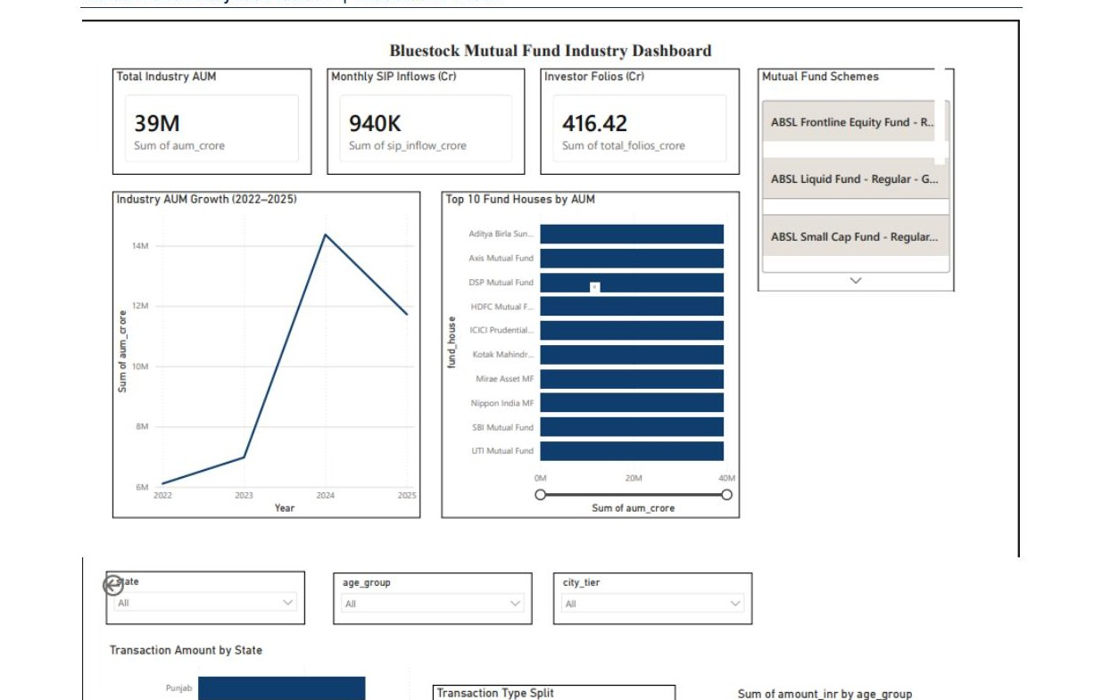
09
Power BI Dashboard — Industry & Performance
Page 1 — Industry Overview
SIP trend, AUM by fund house, folio count growth, category net inflows
Page 2 — Fund Scorecard
Top 10 by 3-yr return, Sharpe vs return scatter, alpha leaderboard
Power BI Desktop · bluestock_mf.pbix
Notes:
Demo Page 1 live if possible. Highlight the slicers for fund_house, category, and plan.

Slide 10
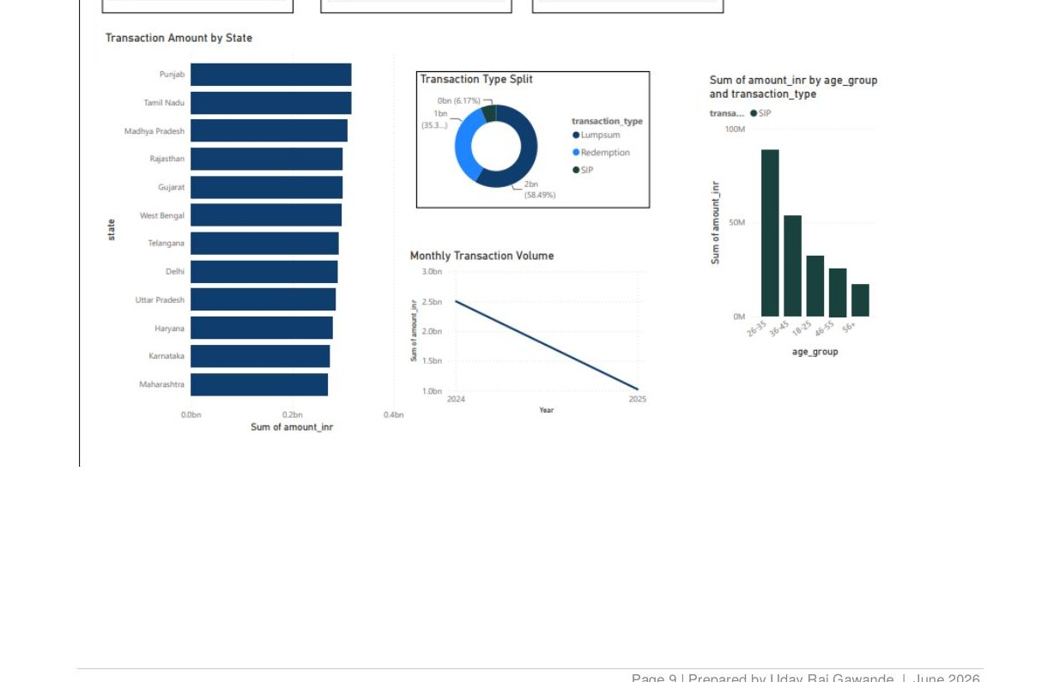
10
Power BI Dashboard — Investor Behaviour & Risk
Page 3 — Investor Behaviour
Transaction type split, state heatmap, age & gender dist., T30 vs B30
Page 4 — Risk & Advanced
VaR/CVaR, HHI heatmap, drawdown vs beta, SIP continuity gauge
Power BI Desktop · bluestock_mf.pbix
Notes:
Point to the SIP continuity gauge — it's the most actionable visual for AMCs.

Slide 11
11
Key Findings & Recommendations
KEY FINDINGS
RECOMMENDATIONS
SIP Surge Monthly inflows grew 170% in 4 years to ₹31,002 Cr.
AMCs & Distributors
• Target B30 cities with digital SIP campaigns • Launch SIP retention programs to close the 65-day gap • Expand female investor outreach (33.5% → higher)
Small Cap Leads 21.7% avg 3-year return — 8-11 pp above Large Cap average.
Liquid = Safest Sharpe 5–8 for liquid funds; ideal for emergency corpus.
For Investors
• Flexi Cap as core holding for balanced risk-return • Liquid funds as emergency corpus (Sharpe 5–8) • Small Cap only for 5+ year horizon
Youth-Led 41% of transactions from 26–35 age group.
Retention Crisis 98% of SIP investors show irregular gaps (avg 64.9 days).
Platform Enhancements
• Real-time NAV alerting system • Rule-based fund recommender engine • Automate ETL with daily AMFI refresh
Urban Bias T30 cities drive 66% of volume; B30 is an untapped opportunity.
Notes:
Present each finding with its supporting number. Recommendations section anchored in data, not opinion.

Slide 12
Thank You

